Slide 1
Introduction to Computer Vision
5. Hough transform Projective transform.
RANSAC.
18.11.22
Mikhail Belyaev

Slide 2
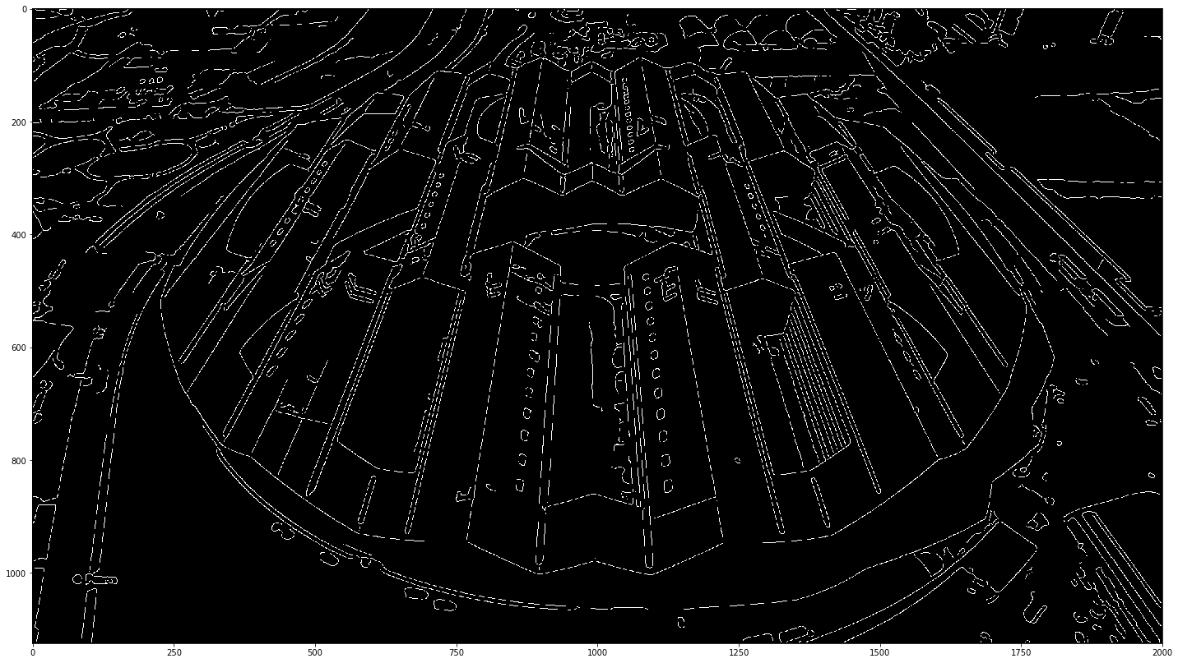
What can we extract from detected edges?

Slide 3
What can we extract from detected edges?
Predefined templates (the lamp counter)
Some figures like squares / circles (today’s seminar!)

Slide 4
What can we extract from detected edges?
Predefined templates (the lamp counter)
Some figures like squares / circles (today’s seminar!)
Lines! How to get parametric equation of a line from edges?

Slide 5
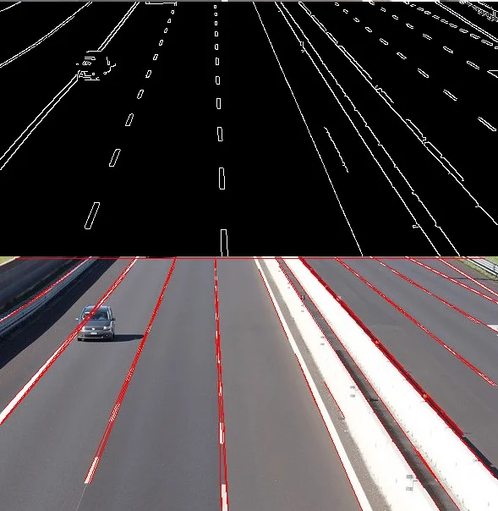
Hough transform
Using Hough transform!
Core idea: try to fit all possible lines and find ones with good fit
Detected lines gives us rotation angle, view point reconstruction
Robust detection under noise
Can detect other structures (not only lines - e.g., circles) if their parametric equation is known
Source: https://learnopencv.com/hough-transform-with-opencv-c-python/

Slide 6
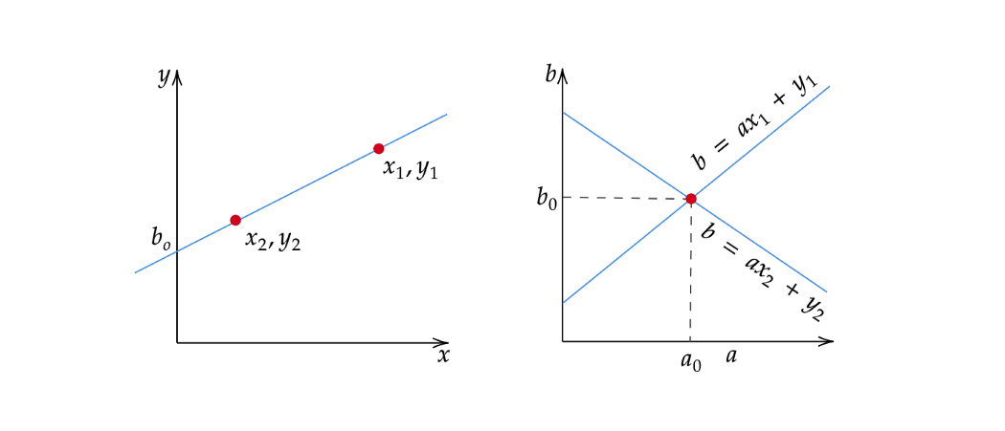
Hough transform
Consider a point of known coordinates (x_{i}; y_{i})
Straight lines that pass that point: y_{i} = a * x_{i} + b
Equation can be rewritten as follows: b = - a * x_{i} + y_{i}
Point (x_{i}; y_{i}) gives us line in (a, b)-space
Source: https://towardsdatascience.com/lines-detection-with-hough-transform-84020b3b1549

Slide 7
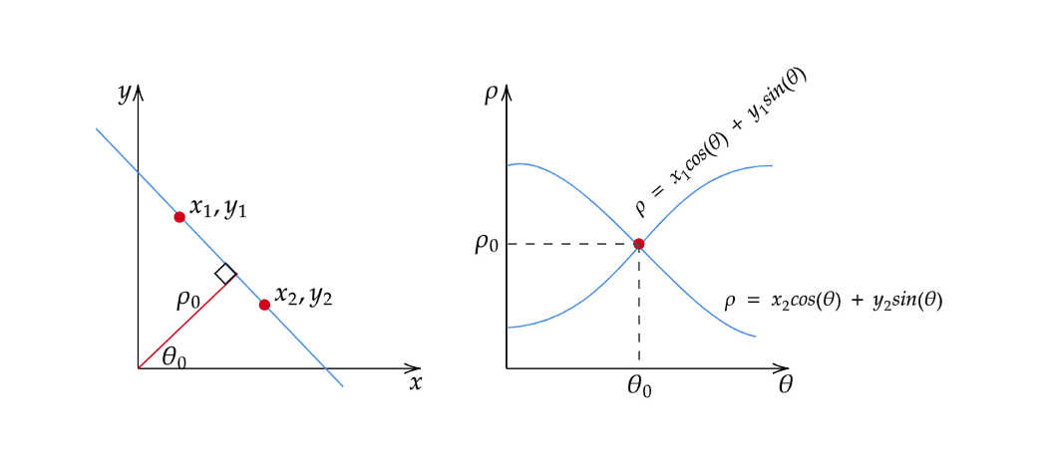
Hough transform parametrization
An alternative parametrization for a linear Hough transform: x cos(θ) + y sin(θ) = r
Source: https://towardsdatascience.com/lines-detection-with-hough-transform-84020b3b1549
Source: Wikipedia

Slide 8
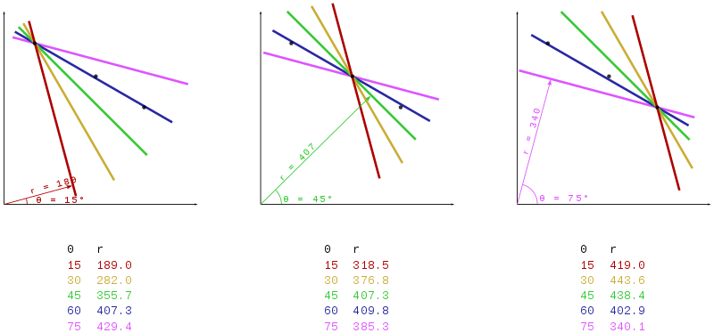
Hough transform parametrization
An alternative parametrization for a linear Hough transform: x cos(θ) + y sin(θ) = r
Source: Wikipedia

Slide 9
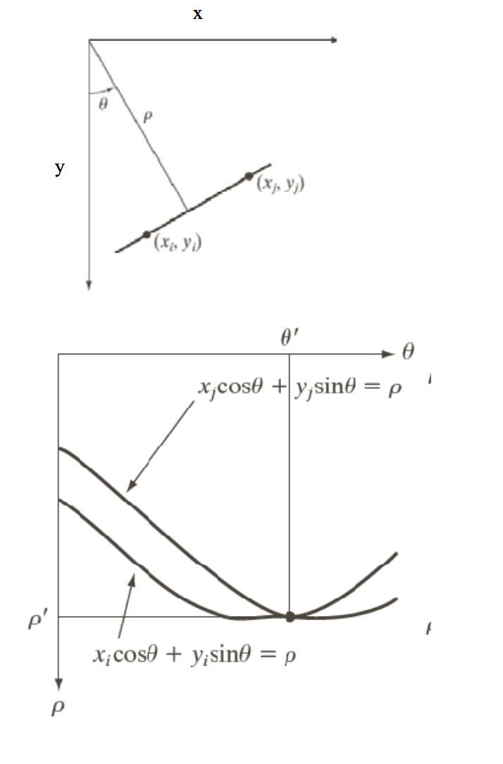
Hough transform
Note that lines in (x y) space are not lines in (ρ θ) space, unlike (a b) space.
A vertical line will have θ=0 and ρ equal to the intercept with the x-axis.
A horizontal line will have θ=90 and ρ equal to the intercept with the y-axis.
Source: J. Niebles

Slide 10
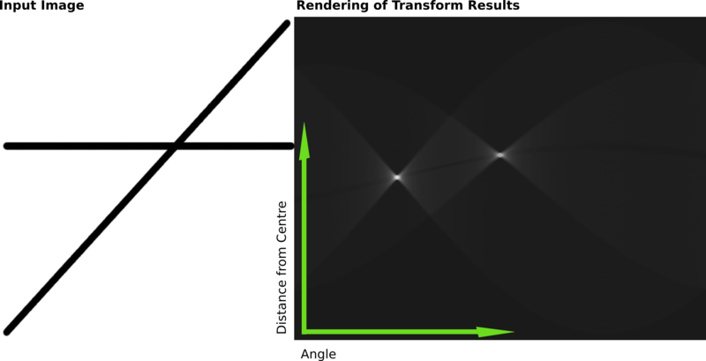
Hough transform
Algorithm:
Detect edges, e.g. via Canny
For every line calculate the intersection with the edges image (= get intensity of all pixels in (a, b) or (r, θ) space)
Filter too similar lines (optional)
Select best lines (= pixels with high intensity values)
Source: Wikipedia

Slide 11
Hough transform
Source: https://homepages.inf.ed.ac.uk/amos/hough.html

Slide 12
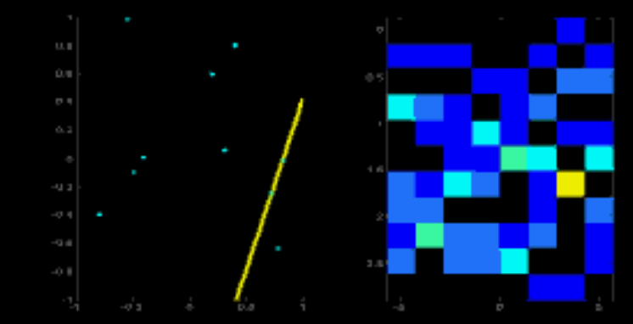
Hough transform
Source: https://homepages.inf.ed.ac.uk/amos/hough.html

Slide 13
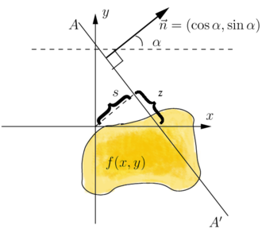
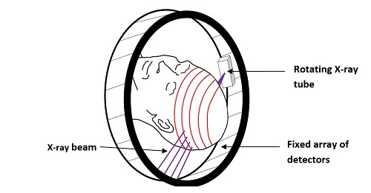
Hough transform parametrization
An alternative parametrization for a linear Hough transform: x cos(θ) + y sin(θ) = r
Is it possible to solve an inverse problem? Can it be useful? Yes, in computed tomography!
The math behind this problem is the inverse Radon transformation. In some sense, Hough can be considered as an engineering approach to calculate discrete Radon transform.
Source: Wikipedia

Slide 14
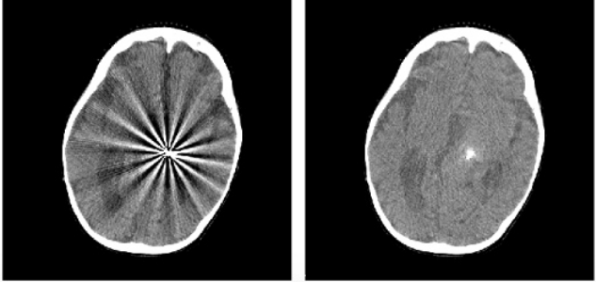
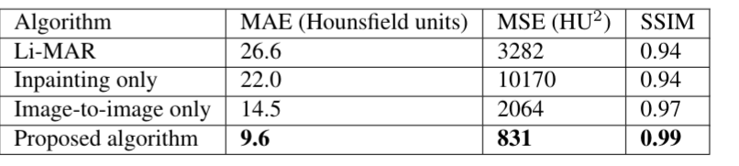
Radiotherapy projects: metal artifacts reduction
A slide from the first lecture
Goals: develop an algorithm to reduce metal artifacts, estimate the impact on dose distribution.
Partners: Radiation therapy department at Burdenko Neurosurgery Institute.
Data: ~50 CT with metal artifacts, ~200 “normal” CT.
Source: Multidomain partial convolutions CNN for metal artifacts reduction on brain CT. Pimkin et al. IJCNN 2020.

Slide 15
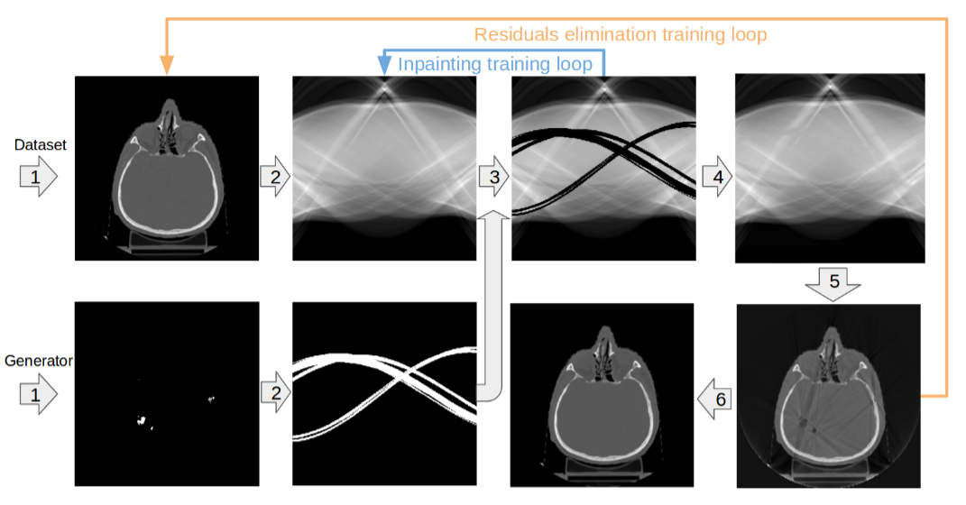
Radiotherapy projects: metal artifacts reduction
Actually we worked in two domains and use Radon & Inverse Radon transformation to switch from one to another.
Source: Multidomain partial convolutions CNN for metal artifacts reduction on brain CT. Pimkin et al. IJCNN 2020.

Slide 16
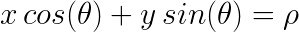
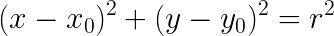
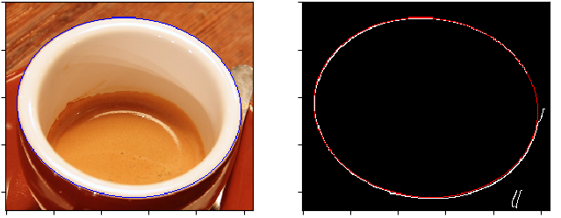
Hough transform parametrization
Straight lines that pass that point: y_{i} = a * x_{i} + b
Equation can be rewritten as follows: b = - a * x_{i} + y_{i}
An alternative parametrization for a linear Hough transform:
A circular Hough transform:
It’s also possible to look for ellipses using skimage

Slide 17
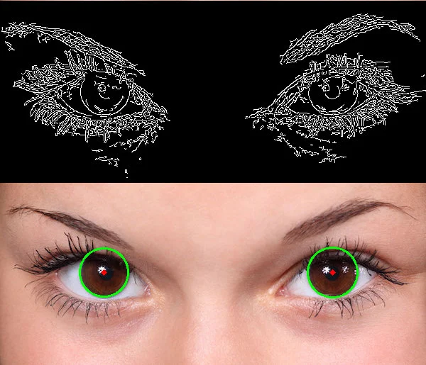
Hough transform parametrization
A circular Hough transform:
Source: https://learnopencv.com/hough-transform-with-opencv-c-python/

Slide 18
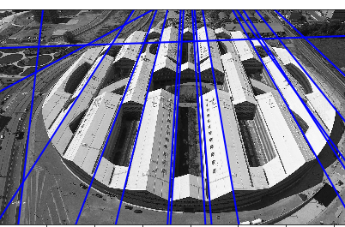
Output of Hough transform

Slide 19
Output of Hough transform
Please name a group of “similar” lines

Slide 20
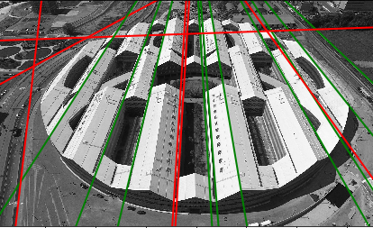
Output of Hough transform
Please name a group of “similar” lines.
Green lines are parallel… Or not?

Slide 21
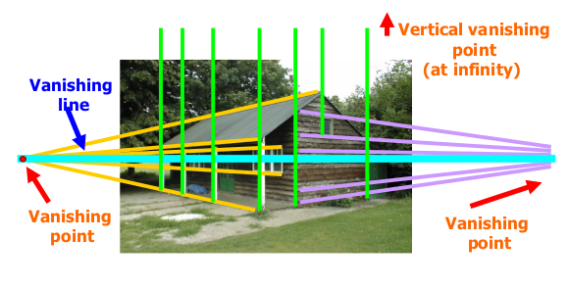
Linear transforms
How can we make yellow / purple lines parallel? Can we do it using a linear transform?

Slide 22
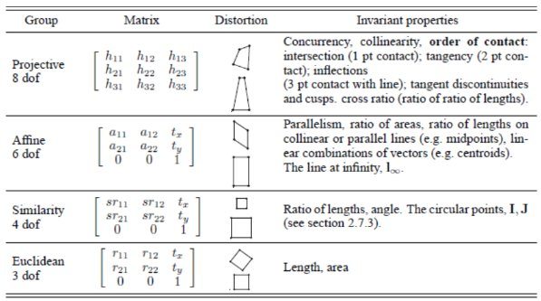
Linear transforms
Source

Slide 23
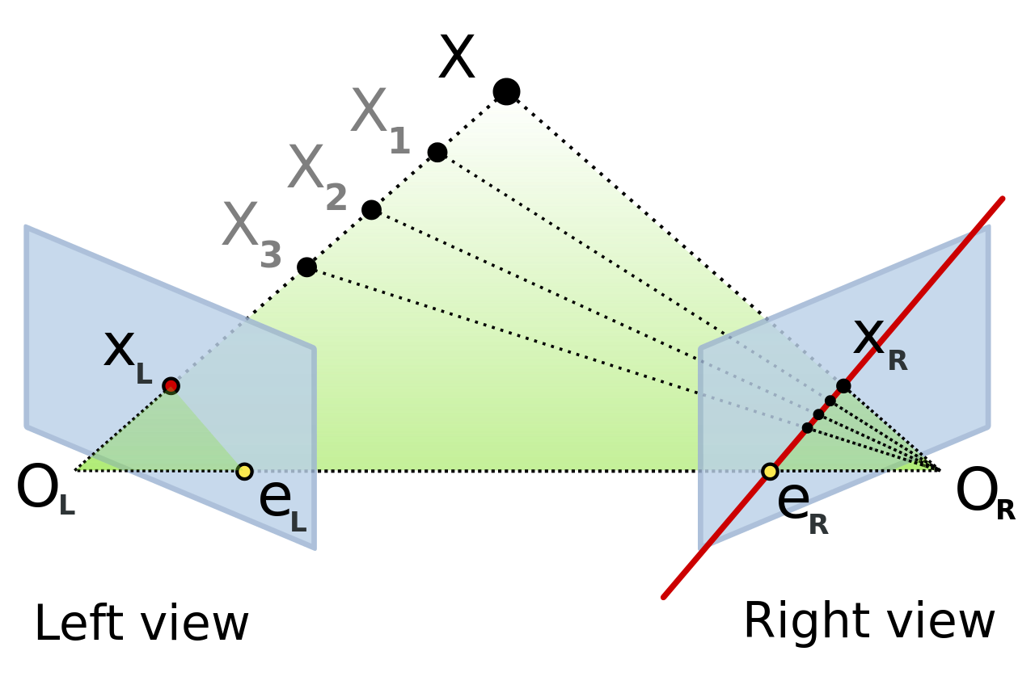

Epipolar geometry
Epipolar geometry - an interesting CV topic which is out of scope for our course. It’s about stereo vision and math behind.

Slide 24
RANSAC algorithm
RANdom SAmple Consensus
RANSAC loop:
Randomly select a seed group of points on which to base transformation estimate (e.g., a group of matches)
Compute transformation from seed group
Find inliers to this transformation
If the number of inliers is sufficiently large, re-compute least-squares estimate of transformation on all of the inliers
Keep the transformation with the largest number of inliers

Slide 25
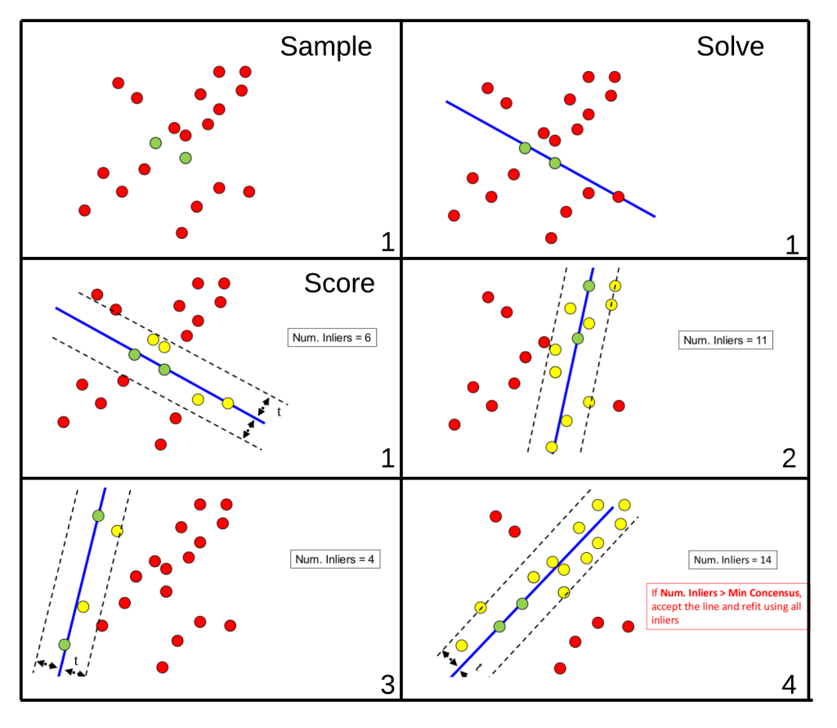
RANSAC algorithm
Source: F. Moreno

Slide 26
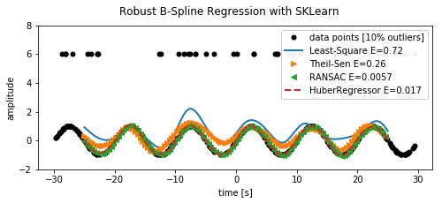
RANSAC algorithm
Source: this github gist

Slide 27
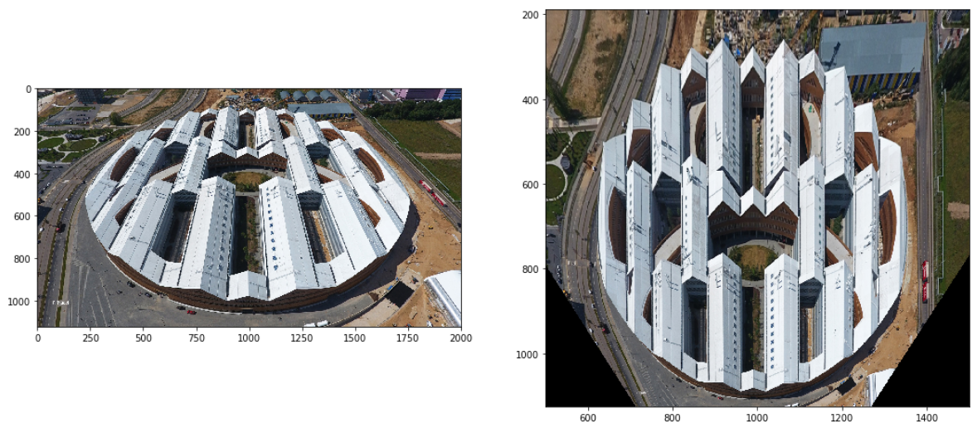
Projective transform + Hough
Exercise: transforming Skoltech
Find edges & lines
Plot lines
Select points to fit ProjectiveTransform via RANSAC

